Slide 1
Recurrent Neural Networks
Hamza Akmal & Sharjeel Ahmad

Slide 2
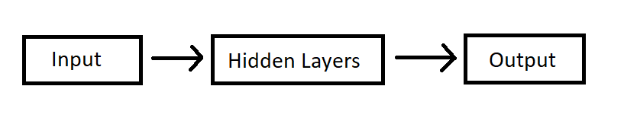
One to one Neural Network
Receive some input which is a fixed sized object
Input fed through a set of hidden layers
Produces a single output

Slide 3
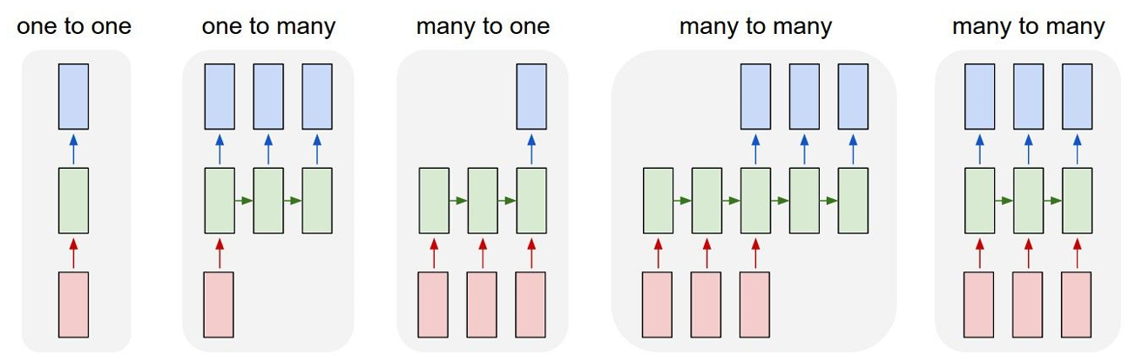
Recurrent Neural Networks: Process Sequences

Slide 4
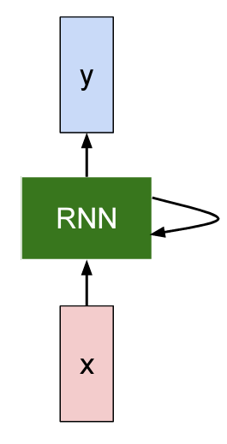
Recurrent Neural Network
Has a recurrent core cell
Takes input and feeds into RNN
RNN has internal hidden state which gets updates
RNN produce output at some frequent time step

Slide 5
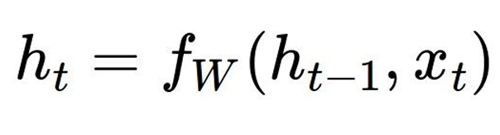
Recurrence Formula

Slide 6
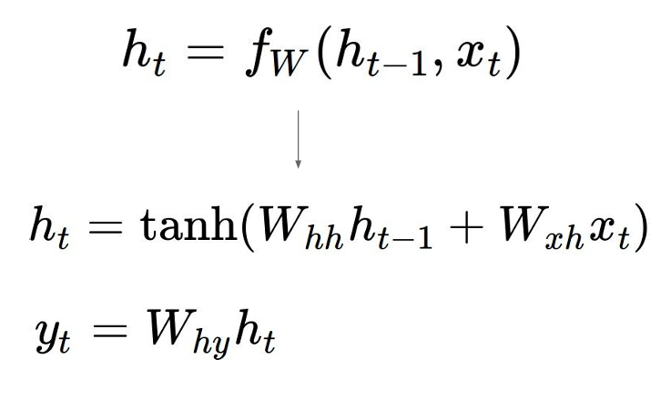
Simple Recurrent Neural Network
Only a single hidden vector “h”

Slide 7
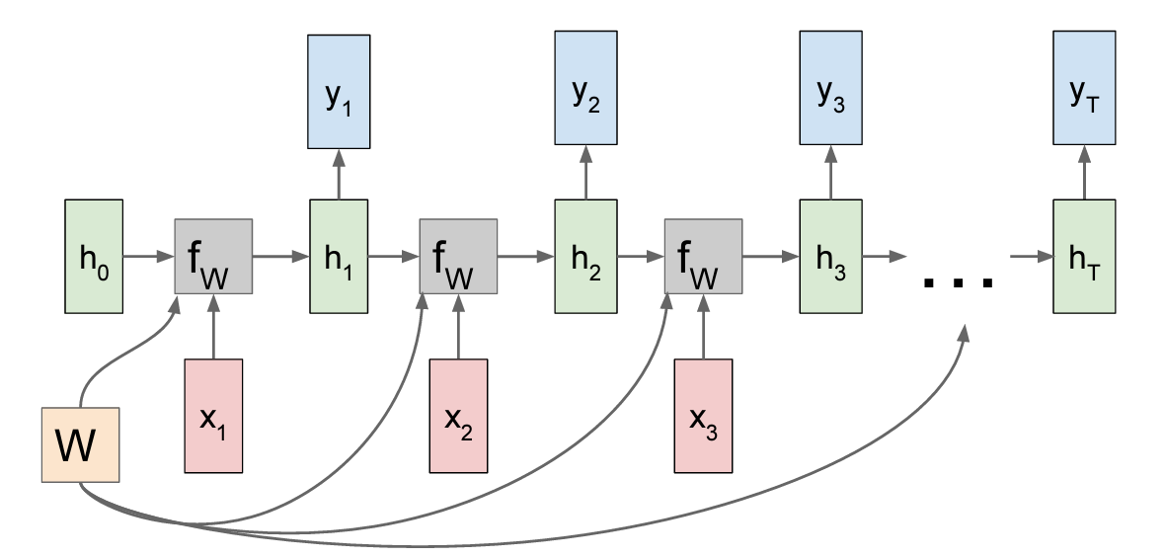
Computational Graph: Many to Many
Re-use the same weight matrix in every step

Slide 8
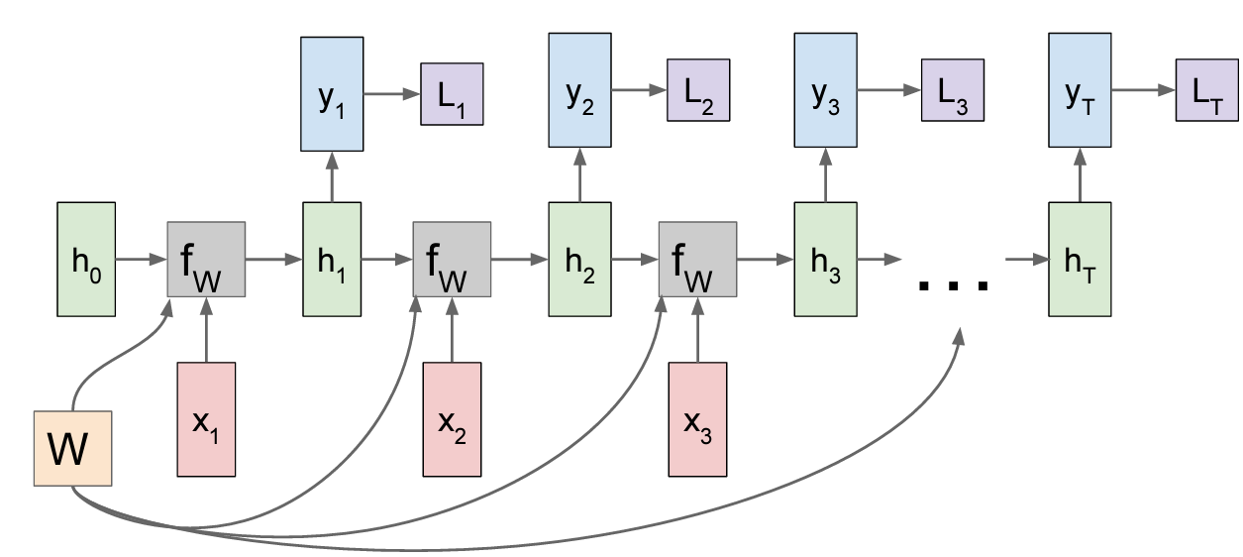
Computational Graph: Many to Many (Loss)

Slide 9
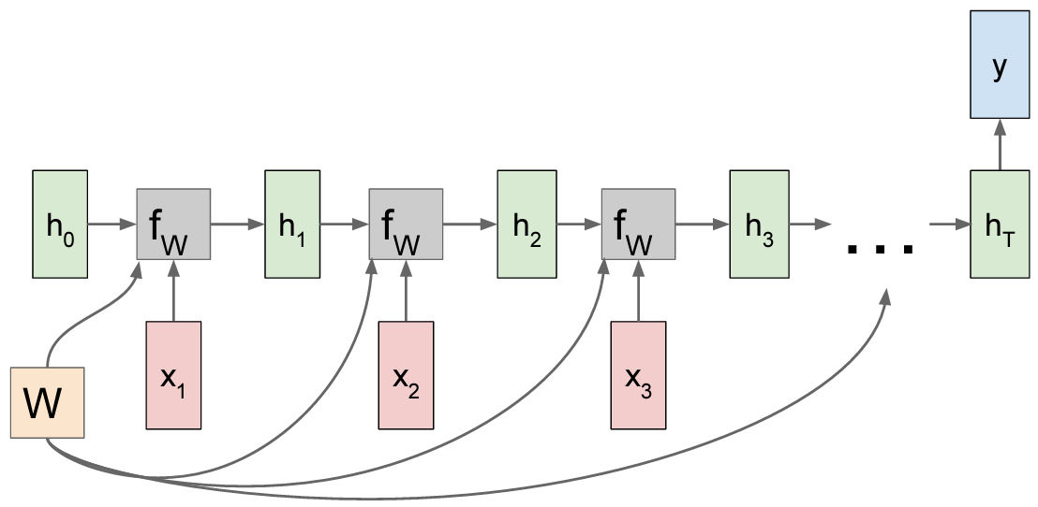
Computational Graph: Many to One

Slide 10
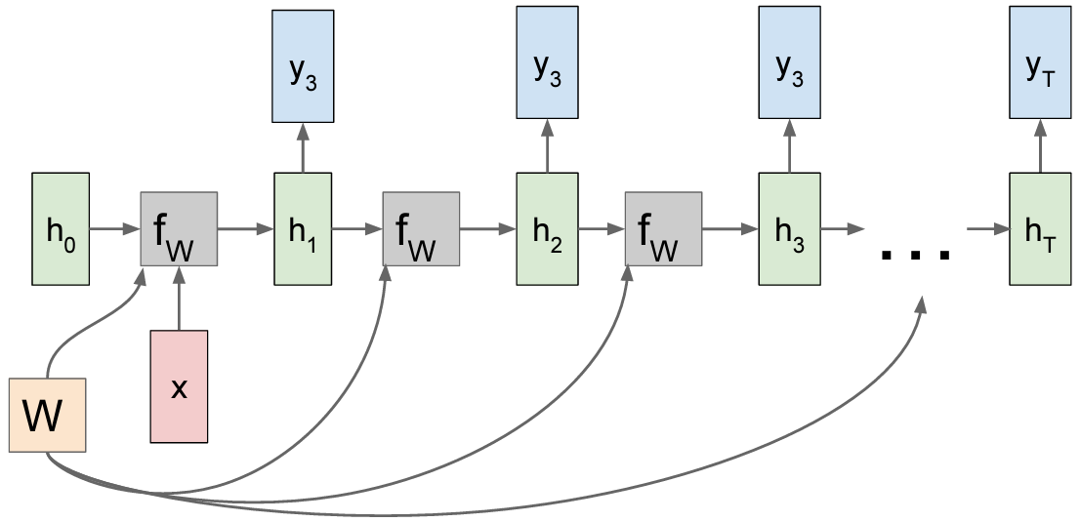
Computational Graph: One to Many

Slide 11
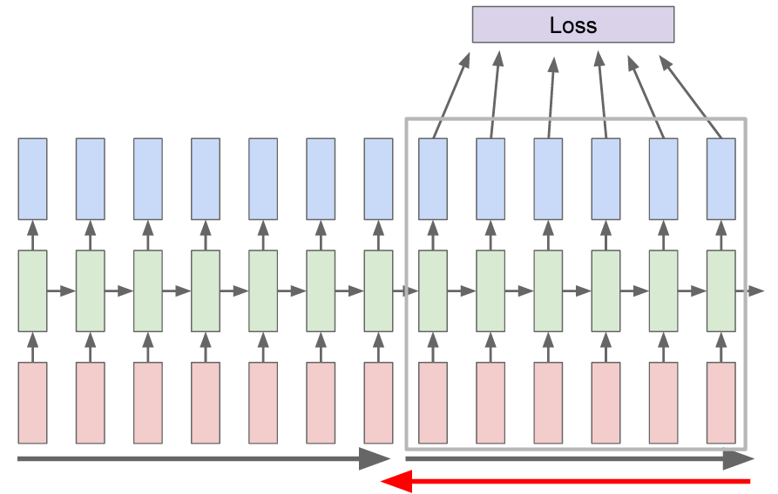
Truncated Backpropagation through time
Regular backpropagation too time consuming and won't converge
Run forward and backward propagation through chunks of sequence instead
Carry hidden states forward in time forever, but only backpropagate for some smaller number of steps

Slide 12
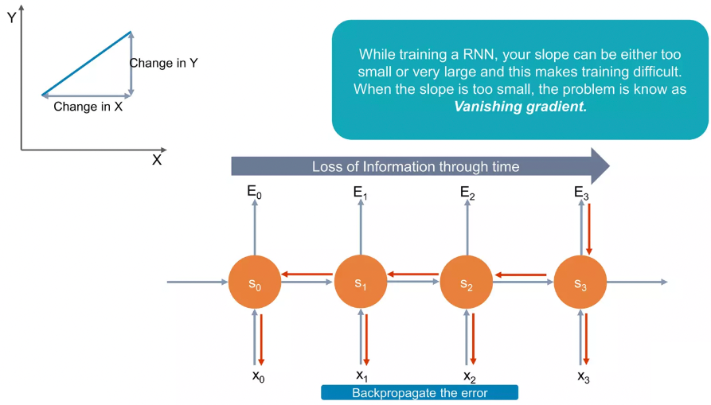
Challenges with RNN: Vanishing Gradients

Slide 13
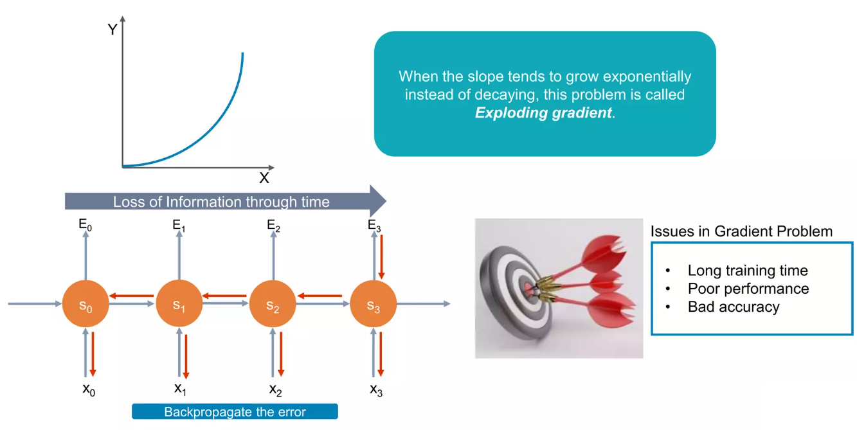
Challenges with RNN: Exploding Gradients

Slide 14
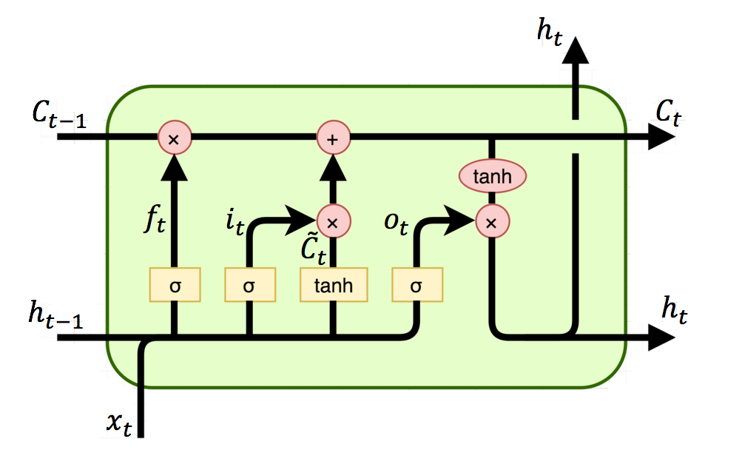
Challenges with RNN: GRU (Gated Rectifying Unit)
Thresholding:
h_{t} = h_{low-thresh}/h_{high-thresh}

Slide 15
Optimization Algorithms for RNNS

Slide 16
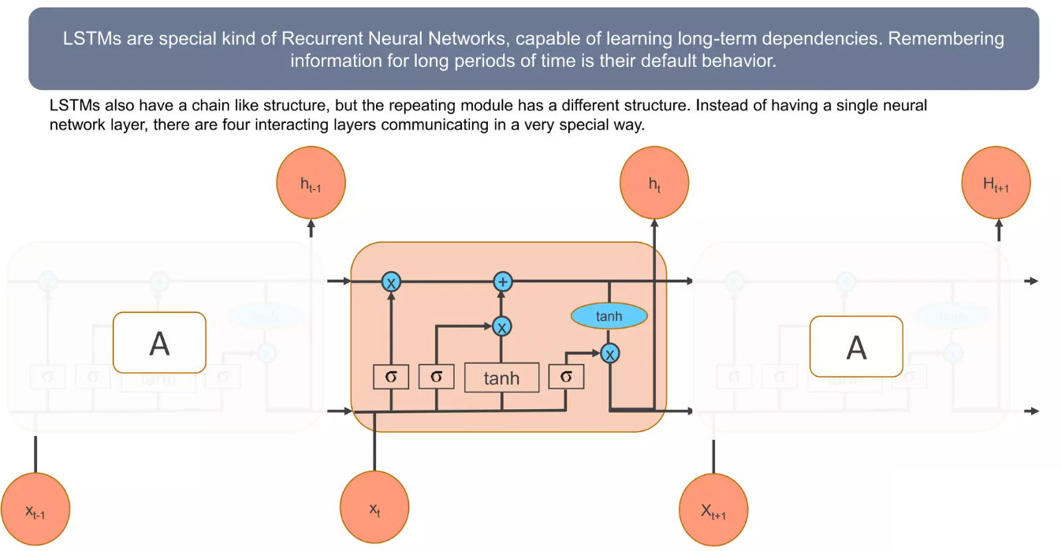
Introduction to LSTMs

Slide 17
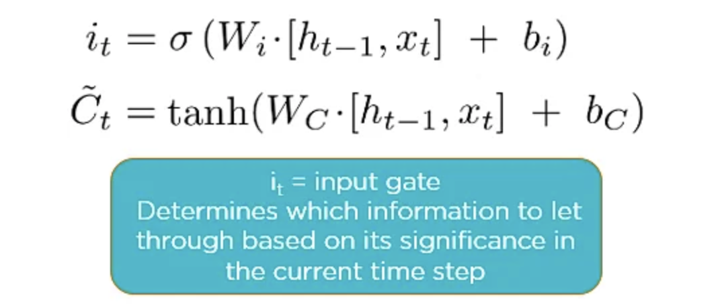
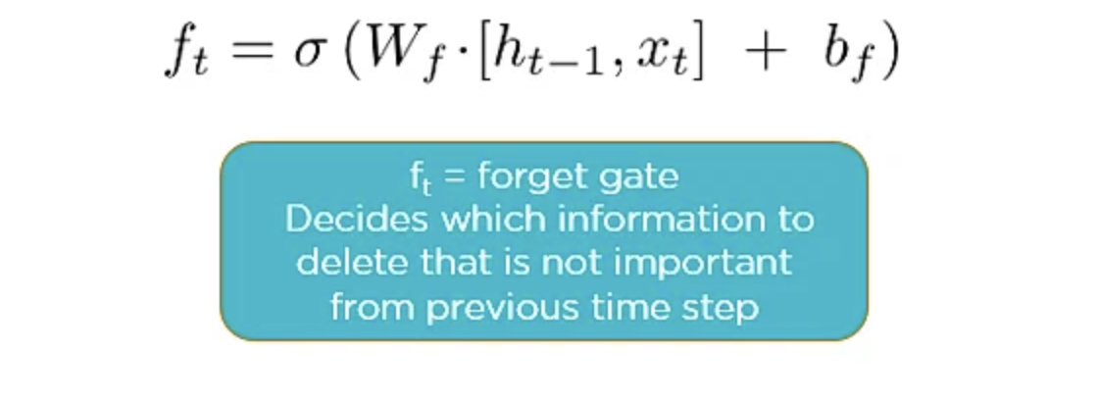
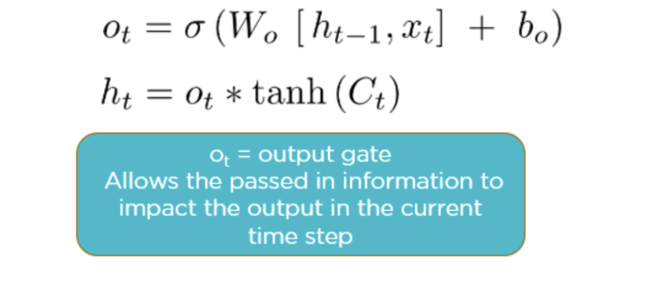

Slide 18
Encoder-Decoder RNNs:
Encoder-decoder RNNs consist of two RNNs: an encoder network that processes the input sequence and produces a fixed-length vector representation of the input and a decoder network that generates the output sequence based on the encoder's representation. This architecture is commonly used for sequence-to-sequence tasks such as machine translation.
Problems:
Run-time complexity (On^2)
Capped dimensionality of input data
Redundant operations while computing dot products

Slide 19
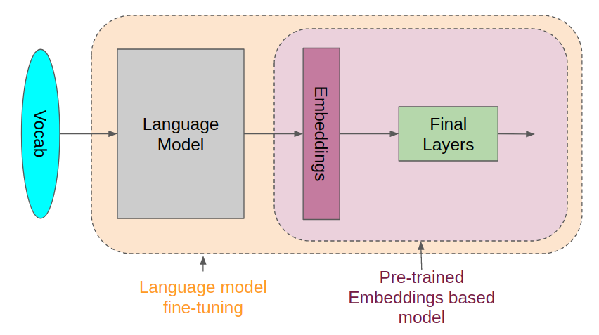
RNNS in Large Language Learning Models

Slide 20
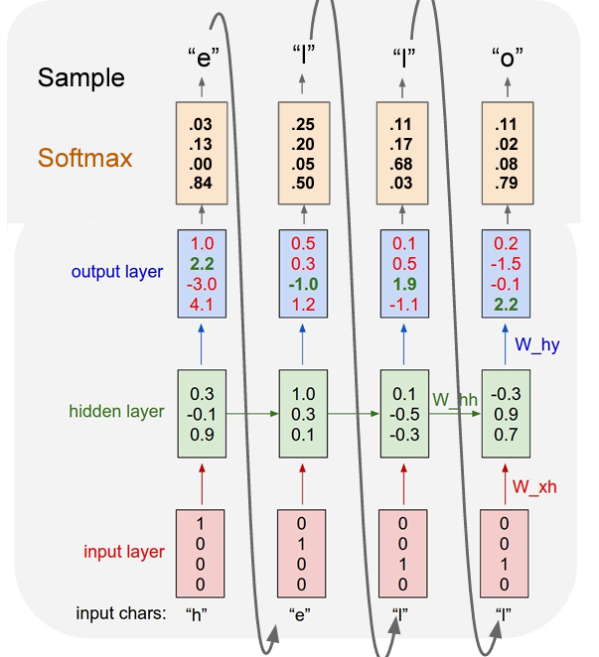
Example: Character Level Language Sampling Model

Slide 21
RNNs in LLMs:
Trained in a completely unsupervised way
Reduce data sparsity
Semantic Hashing
Appear to carry semantic information about the words
Freely available for out of box usage

Slide 22
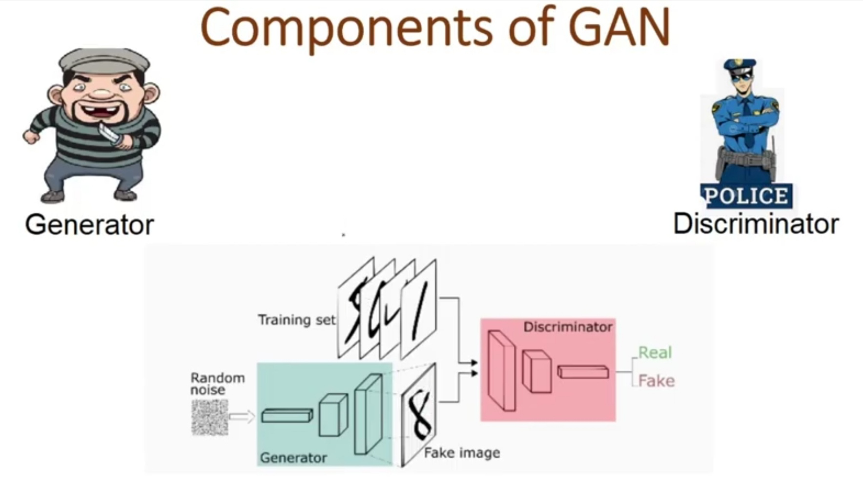
RNNs in Generative Adversarial Networks

Slide 23

Made using RNNs :)

